Slide 1

OOP -
Object Oriented Programming

Slide 2

Dastur kutilgandek ishlamayabdi…

Slide 3


Slide 4
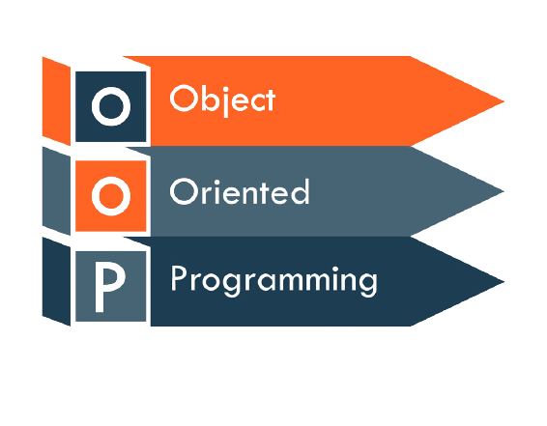
OOP nima?
OOP – dasturlash olamida keng tarqalgan dasturiy paradigma (model) hisoblanib, dastur dizaynini aynan obyektlar asosiga qurish uchun foydalaniladi.

Slide 5
Dasturiy paradigma – bu dastur yozish usuli. Ya’ni dasturni qanday qurish yuzasidan o’ylab topilgan ishlanma.
Dasturiy paradigma nima?

Slide 6

Procedural Programming
f()
x
f()
x

Slide 7
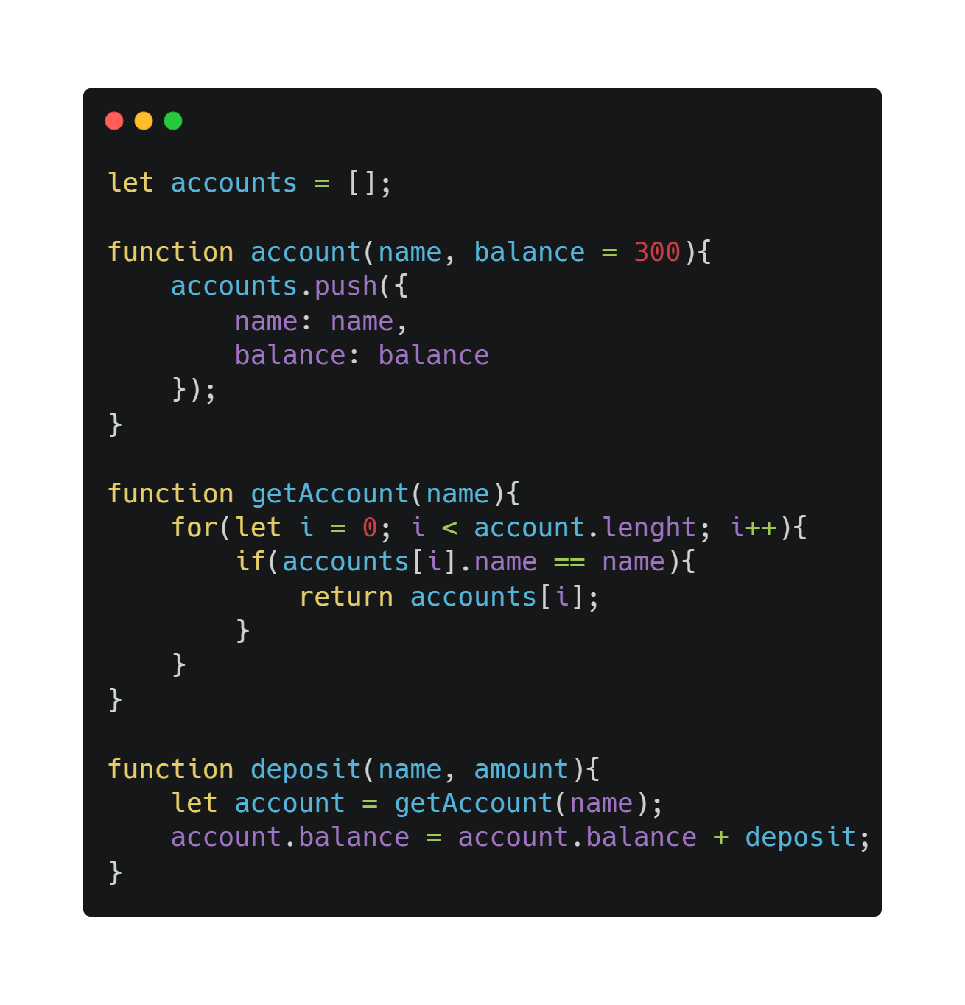

Slide 8
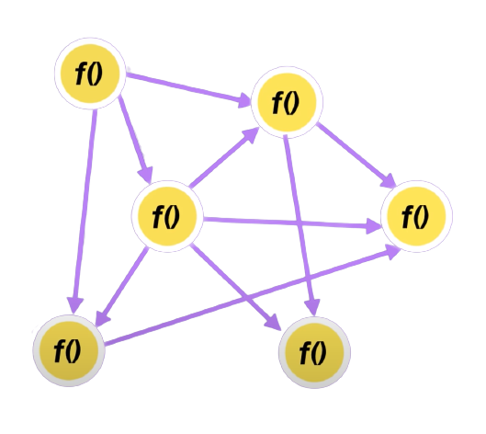

Slide 9
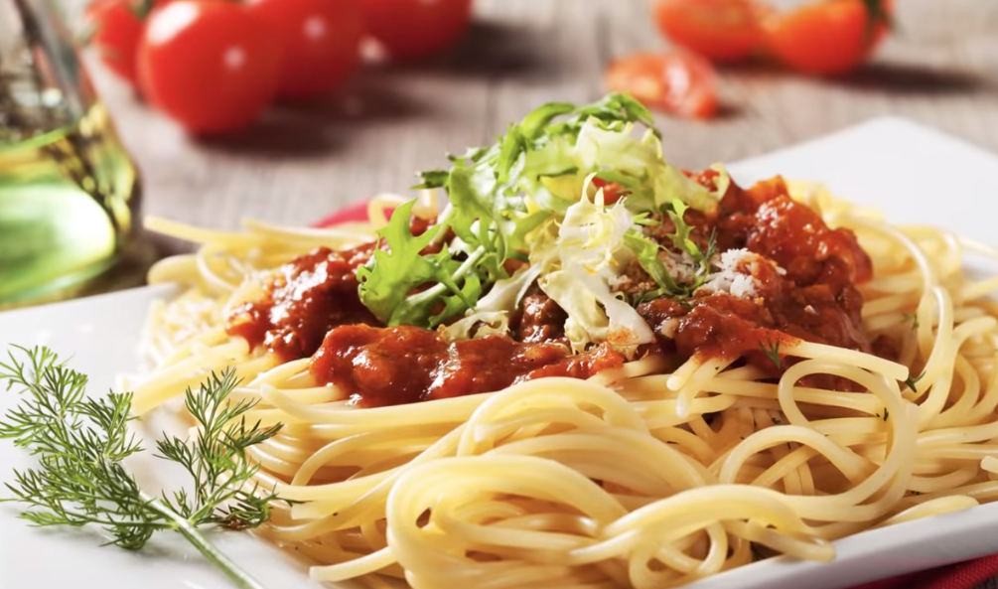

Slide 10
Property
f()
x
Method
f()
x

Slide 11
Car
model
color
brand
Start()
Stop()
Move()

Slide 12
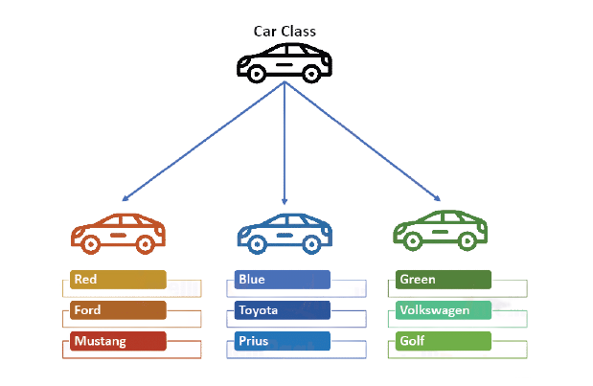

Slide 13
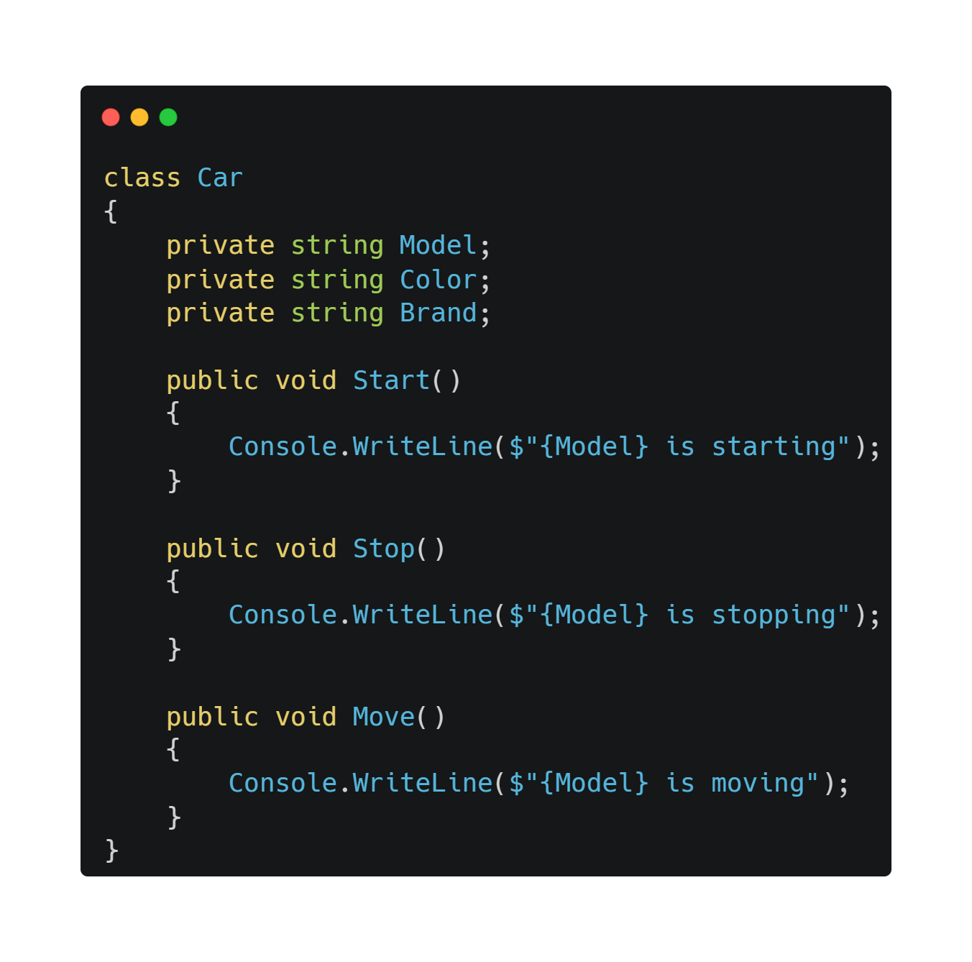

Slide 14
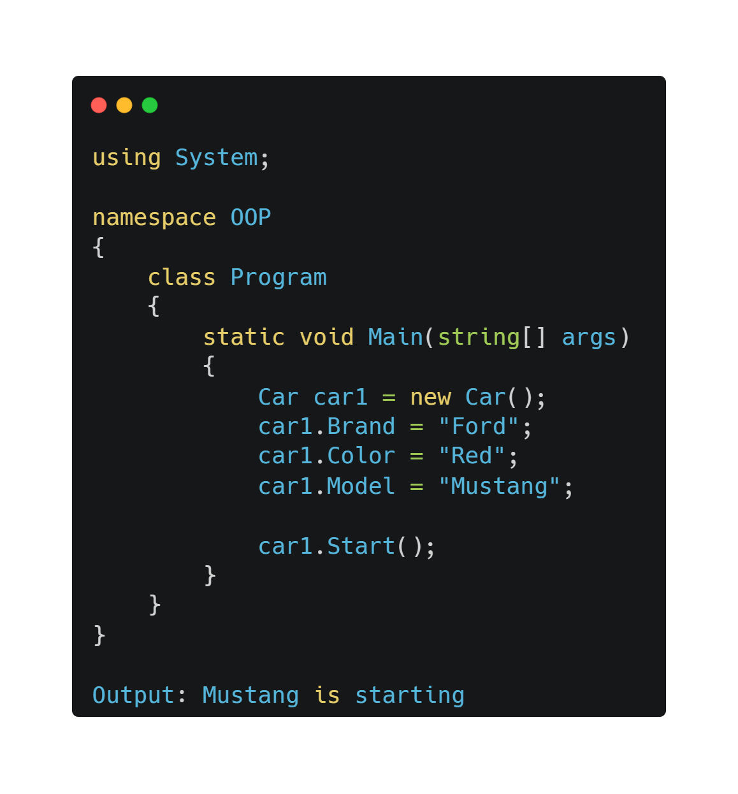

Slide 15
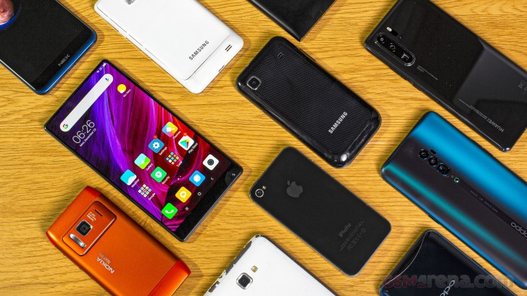

Slide 16
Mobile Phone
Nokia
Sumsung
IPhone

Slide 17
